Slide 1
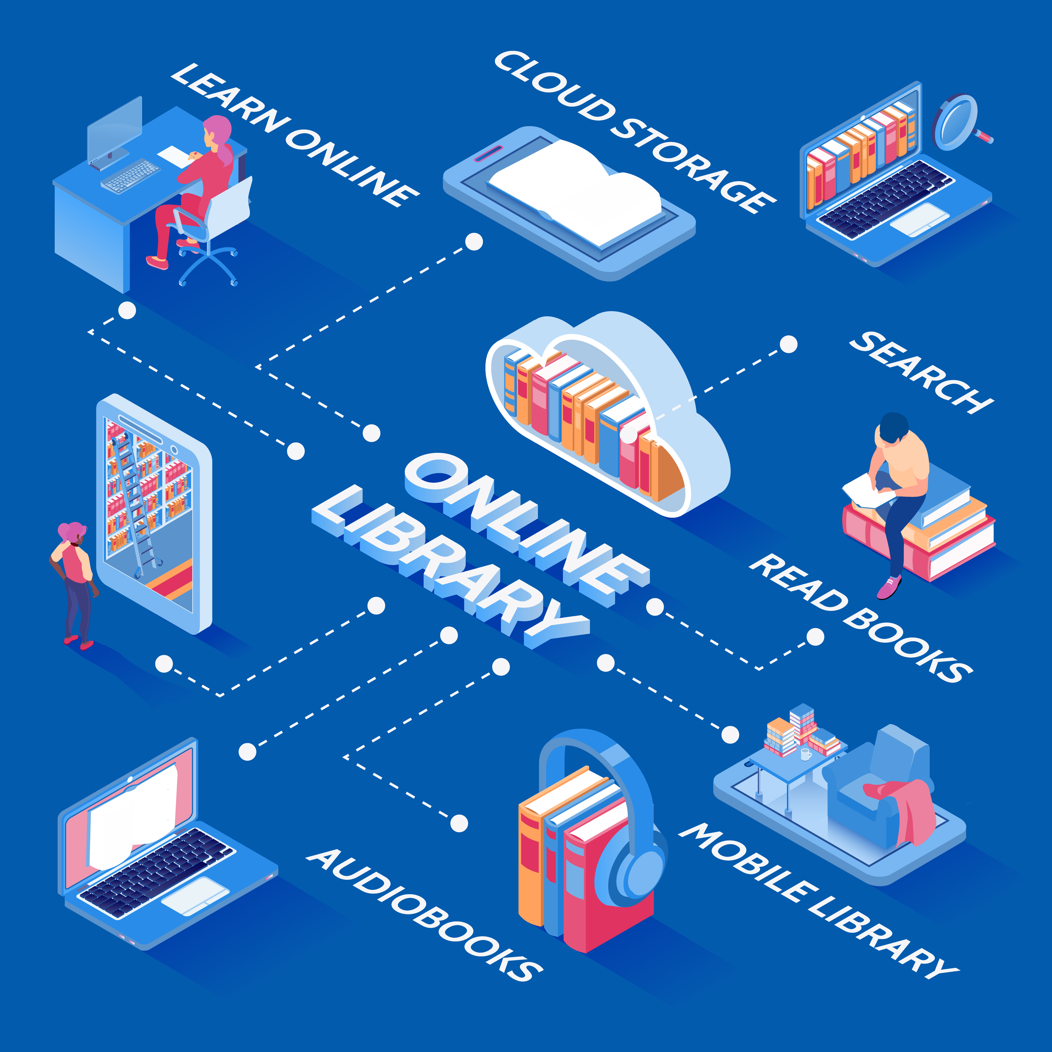

Library Management System (LMS)
Java Programming
Team Members:
Anwesh Mohanty – 240301120207
Prabhudutta Mangaraj - 240301120203
Biswa Ranjan Ranasingh- 240301120214
Biswa Ranjan Mohanty – 240301120193
Soumya Ranjan Panda - 240301120187

Slide 2


CONTENT
Introduction
System Workflow
Objectives
Technology Stack
Key Features
Advantages of the LMS
System Architecture
Challenges and Limitations
Modules in LMS
Future Enhancements
Database Design
Conclusion

Slide 3

Introduction to (LMS)
A Library Management System (LMS) is a digital solution designed to streamline the daily operations of a library. It enables librarians and users to efficiently manage and access a vast array of resources, including books, journals, and digital media, all through a centralized system. With a few clicks, users can search for resources, track availability, and manage borrowings, making it easier to keep the library organized and accessible.
Purpose of Implementing an LMS
Organizing Library Resources:
An LMS categorizes and stores item details like titles, authors, and ISBNs, making retrieval and management easy.
2. Tracking Borrowings and Returns:
An LMS automates book check-outs, tracking availability and ensuring accountability.
3. Managing Library Resources Efficiently:
An LMS manages inventory with due date alerts and borrowing history, while generating reports on popular books and inventory status.

Slide 4
Objectives of the (LMS)
1. To Automate Library Tasks
The LMS automates various library operations, such as cataloging, issuing, and returning books. By reducing the reliance on manual processes, it saves time and allows library staff to focus on more strategic activities, such as community engagement and program development.
2. To Facilitate Easy Tracking of Books and Users
An LMS simplifies the tracking of library resources and user activities. Users can quickly search for books, check availability, and manage their accounts online. Library staff can efficiently monitor inventory levels, track overdue items, and maintain accurate records of all transactions.
3. To Reduce Errors and Manage Resources Efficiently
By minimizing manual input and automating routine tasks, an LMS significantly reduces the risk of human errors, such as incorrect check-outs or data entry mistakes. This ensures accurate record-keeping and efficient management of library resources, leading to better service and satisfaction for both staff and patrons.

Slide 5

Key Features of (LMS)
1. Cataloging: Organizes and stores information about books, journals, and e-books by title, author, genre, and publication date for easy access.
2. Search and Retrieval: Allows users to effortlessly locate items using criteria like title, author, genre, or ISBN, enhancing user experience.
3. Issue and Return Tracking: Automates the management of check-outs and returns, tracking borrowed items and due dates to reduce overdue risks.
3. User Management: Maintains detailed records of library members, enabling easy registration, profile management, and tracking of borrowing history.
3. Reports and Analytics: Provides insights into borrowing trends and popular items, aiding in informed decisions for resource acquisition and program development.

Slide 6
System Architecture of (LMS)
1. Client-Server Model
Client Side:
User interface where librarians and users interact with the system.
Can be developed in Java using frameworks like JavaFX or Swing.
Handles user requests, displays information, and interacts with the server.
Server Side:
Manages data storage and processing.
Runs on a web server and handles client requests.
Processes data and sends responses back to the client.
Often developed using Java EE or Spring Framework for scalability.
2. Web-Based System
Overview:
Accessed through a web browser for easy user interaction.
Front end built using HTML, CSS, and JavaScript.
Backend developed in Java for robust processing.
Allows access from any device with internet connectivity.
3. Reports and Analytics: Provides insights into borrowing trends and popular items, aiding in informed decisions for resource acquisition and program development.

Slide 7
System Architecture of (LMS)
3. Key Components
User Interface (UI):
The interaction point for users to search for books and manage accounts.
Should be intuitive and user-friendly for seamless transactions.
Java technologies like JavaFX or JSP can be utilized for development.
Database:
Stores all library data, including book records and user profiles.
Typically uses a relational database management system (RDBMS) like MySQL or PostgreSQL.
Java Database Connectivity (JDBC) enables communication between the Java application and the database.
Backend Services:
Handles business logic and processes client requests.
Includes components like controllers and data access layers for data flow management.
Java frameworks like Spring Boot simplify development and provide RESTful APIs for communication.
3. Reports and Analytics: Provides insights into borrowing trends and popular items, aiding in informed decisions for resource acquisition and program development.

Slide 8

Modules in (LMS)
1. User Module
Member Registration: Facilitates new member registration, capturing essential info like name and contact details.
User Profiles: Allows users to create and manage profiles, including personal info, borrowing history, and current loans.
2. Book Management Module
Adding Books: Enables librarians to input new book details like title, author, and ISBN.
Updating Books: Provides functionality to modify existing book info, such as status and details.
Deleting Books: Allows removal of books from the catalog when they are no longer available.

Slide 9
Modules in (LMS)
3. Transaction Module
Issue Management: Handles the checkout process, updating inventory and recording due dates.
Return Management: Manages the return process, updating availability and notifying users of overdue items.
Fine Management: Calculates and tracks fines for overdue books, enabling users to pay through the system.
4. Admin Module
Overseeing System Functions: Provides tools for administrators to monitor system performance and manage user activities.
Updating Catalog: Allows admins to add or remove books and manage categories to keep the catalog current.
Generating Reports: Offers reporting features to analyze library usage, borrowing trends, and inventory statistics.

Slide 10
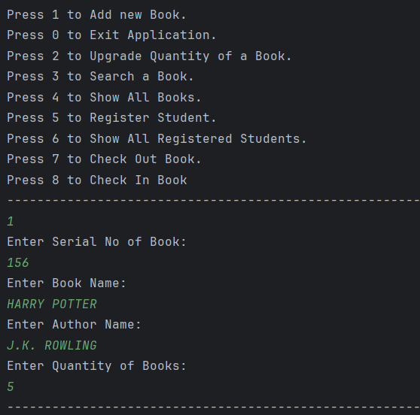
OUTPUT / FEATURES OF THE SYSTEM:-

Slide 11
Database Design for (LMS)
1. Books Table
Purpose: Stores relevant information about the library's collection.
Key Fields:
BookID (Primary Key): Unique identifier for each book.
Title: Title of the book.
Author: Author(s) of the book.
ISBN: International Standard Book Number for unique identification.
Genre: Category or genre of the book.
Availability: Status indicating if the book is available or checked out.
2. Members Table
Purpose: Holds information about library members.
Key Fields:
MemberID (Primary Key): Unique identifier for each member.
Name: Full name of the member.
ContactDetails: Phone number and/or email address.
MembershipType: Type of membership (e.g., student, faculty).
RegistrationDate: Date of membership registration.

Slide 12
Database Design for (LMS)
3. Transactions Table
Purpose: Tracks the borrowing and returning of books.
Key Fields:
TransactionID (Primary Key): Unique identifier for each transaction.
MemberID (Foreign Key): Links to the Members table to identify the borrower.
BookID (Foreign Key): Links to the Books table to identify the borrowed book.
IssueDate: Date the book was checked out.
DueDate: Date the book is due to be returned.
ReturnDate: Date the book was actually returned.
4. Admins Table
Purpose: Contains information about system administrators.
Key Fields:
AdminID (Primary Key): Unique identifier for each admin.
Username: Admin’s username for system access.
Password: Secure password for authentication.
ContactDetails: Phone number and/or email address.

Slide 13
System Workflow of (LMS)
1. How the System Operates
User Login
Users (members and admins) enter credentials (username and password) to access the system.
The system verifies credentials and grants access based on user roles (member or admin).
Book Search
Users can search for books using filters such as title, author, genre, or ISBN.
The system retrieves and displays relevant results from the database.
Book Issue
Members select a book they wish to borrow and request to check it out.
The system verifies the book's availability and updates the Transactions table with the member's details, issue date, and due date.
The book’s status in the Books table is updated to reflect that it is checked out.
Book Return
Members return books through the system interface.
The system updates the Transactions table to record the return date and calculates any overdue fines, if applicable.
The book’s status in the Books table is updated to reflect its availability.
Admin Functions
Admins can add, update, or delete book records in the system.

Slide 14
Technology Stack for (LMS)
1. Programming Languages
Java:
Primary programming language for developing the Library Management System.
Provides robustness, portability, and strong community support for enterprise applications.
Java frameworks like Spring can be utilized for scalable and maintainable backend services.
JavaScript:
Often used alongside HTML/CSS for frontend development.
Enhances interactivity and provides dynamic features within the web application.
2. Database
MySQL:
A relational database management system (RDBMS) for storing and managing library data.
Known for reliability, ease of use, and ability to handle large volumes of data efficiently.
Java Database Connectivity (JDBC) facilitates communication between the Java application and MySQL.
Spring Framework:
A comprehensive framework for Java that simplifies enterprise application development.

Slide 15

Advantages of (LMS)
1. Efficient Management of Library Resources
Streamlined Operations: Automates tasks like book cataloging, inventory management, and tracking borrowed items for better organization.
Real-time Updates: Provides up-to-date information on book availability, member accounts, and transactions for efficient operations..
2. Time-Saving and User-Friendly
Quick Access: Users can quickly search for books, check availability, and perform transactions without lengthy manual processes.
Intuitive Interface: A user-friendly design allows both librarians and members to navigate the system easily, enhancing overall efficiency.
2. Reduces Manual Errors and Paperwork
Automated Processes: Minimizes human intervention in data entry and management, significantly reducing chances of errors.
Digital Records: Eliminates the need for physical paperwork, improving accuracy in record-keeping and easier data retrieval.

Slide 16

Challenges and Limitations of (LMS)
1. Initial Setup Cost and Data Migration
High Initial Investment: Implementing the LMS requires significant upfront costs, including software licensing, hardware purchases, and infrastructure upgrades.
Data Migration Difficulties: Transferring existing library data from manual records or outdated systems can be complex and time-consuming, needing careful planning to ensure data integrity.
2. Training Staff and Users on the New System
Training Requirements: Staff and users may need extensive training to become proficient with the new system, which can be resource-intensive and disrupt operations.
Resistance to Change: Some staff or users may resist adopting new technology, making it essential to implement change management strategies to foster acceptance.
2. Regular Maintenance and Updates
Ongoing Maintenance Needs: The LMS requires regular maintenance to address bugs, ensure security, and manage system performance, which may need dedicated IT support.
Need for Updates: Regular updates are necessary to keep the system relevant and efficient, which can incur additional costs and require further training for staff and users.

Slide 17
Future Enhancements for (LMS)
1. Adding More Features
E-book Integration: Incorporate e-book lending capabilities for users to borrow digital books alongside physical ones.
Multimedia Support: Expand the system to include various multimedia resources like audiobooks, videos, and educational content to cater to diverse user preferences.
2. Implementing AI for Book Recommendations
Personalized Recommendations: Use AI algorithms to analyze user borrowing history and preferences, providing tailored book recommendations for better engagement.
Smart Search Functionality: Implement AI-driven search capabilities to allow users to find books based on complex queries and natural language processing for improved accuracy.
2. Mobile App Integration for Easier Access
Mobile Application Development: Create a mobile app for users to access library resources, search for books, manage accounts, and receive notifications on the go.
User-Friendly Interface: Design the app to provide a seamless experience, making it easier for members to engage with library services anytime and anywhere.

Slide 18
Conclusion
LMS Benefits
Enhanced Efficiency: The LMS streamlines operations by automating tasks like cataloging, inventory management, and transaction tracking for better resource allocation.
Improved User Experience: Features such as easy book search, online transactions, and personalized recommendations enhance user satisfaction and accessibility.Reduced Errors: Automation minimizes manual handling, decreasing the risk of data entry errors and improving accuracy in library management.
Transforming the Library Experience
For Staff: The LMS simplifies administrative tasks, enabling staff to focus on quality service and user engagement, improving overall library operations.
For Users: With a modern interface and easy access to resources, the LMS makes it convenient for users to find, borrow, and manage library materials anytime, anywhere.

Slide 19
THANK YOU

